Slide 1

MSc in Applied Computational Science and Engineering
Independent Research Project
A Machine Learning Approach to the Prediction of Tidal elevation
by
Chen Qian
Supervisor: Professor Matthew Piggott

Slide 2
Content
Introduction
Software & Description
Implementation & Code
Performance Analysis
Discussion & Conclusion
Q & A

Slide 3
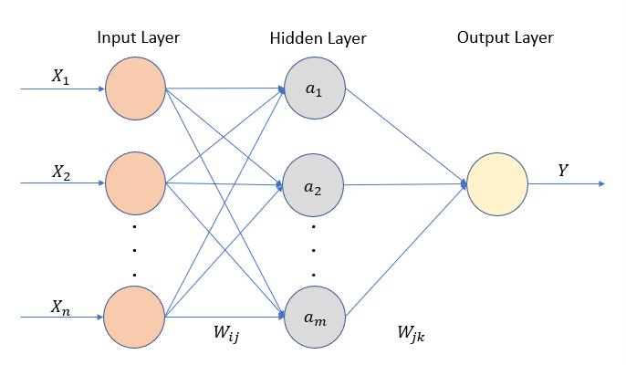
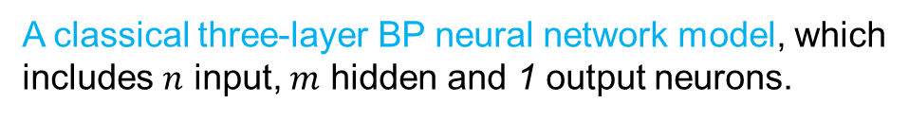
Introduction
Accurate tidal prediction is of great significance for the effective generation of energy.
This project proposes one prediction model combining periodic analysis and back propagation (BP) neural network.
By learning the correlation between training samples and training labels, the BP neural network can determine the fitting weight coefficients of the prediction curve.
A classical three-layer BP neural network model, which
includes $n$ input, $m$ hidden and 1 output neurons.

Slide 4
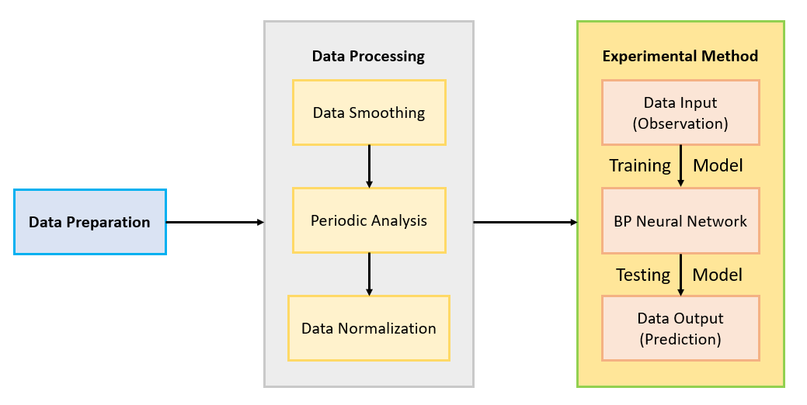





Software & Description
The software consists of several parts, which can be divided into three types: data preparation, data processing, and experimental method.
Platform and Libraries

Slide 5
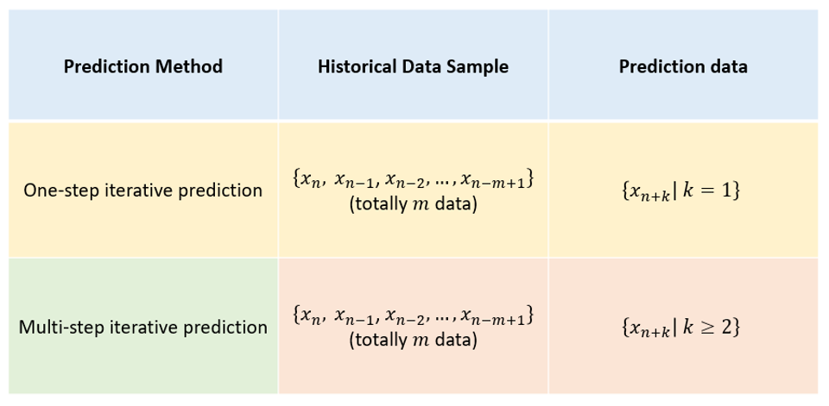
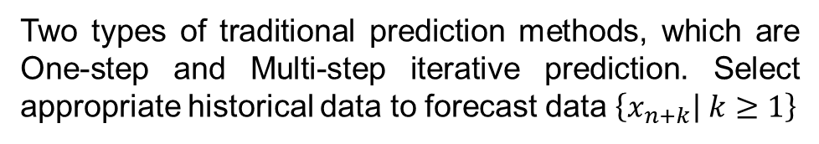
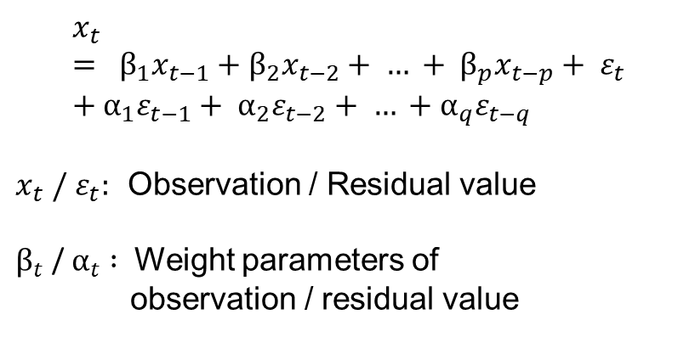
Software & Description
Concerning one-step iterative prediction, one new improved prediction method is introduced based on it, which is autoregressive moving average model (ARMA)
$$x_{t}= β_{1}x_{t−1}+β_{2}x_{t−2}+ … + β_{p}x_{t−p}+ ε_{t}+α_{1}ε_{t−1}+ α_{2}ε_{t−2}+ … +α_{q}ε_{t−q}$$
$x_{t} /{ ε}_{t}:$ Observation / Residual value
$β_{t}$ / $α_{t} :$ Weight parameters of
observation / residual value
Two types of traditional prediction methods, which are One-step and Multi-step iterative prediction. Select appropriate historical data to forecast data $\left\{x_{n+k} | k≥1\right\}$

Slide 6
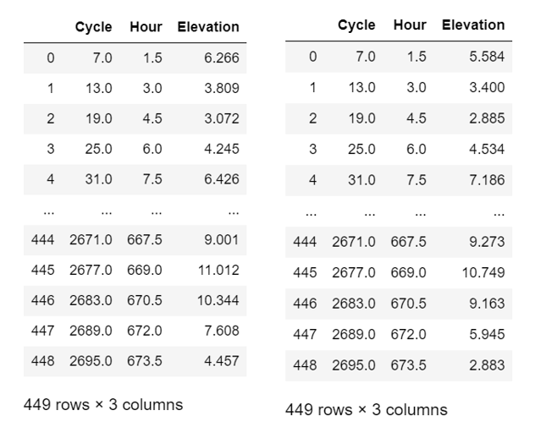
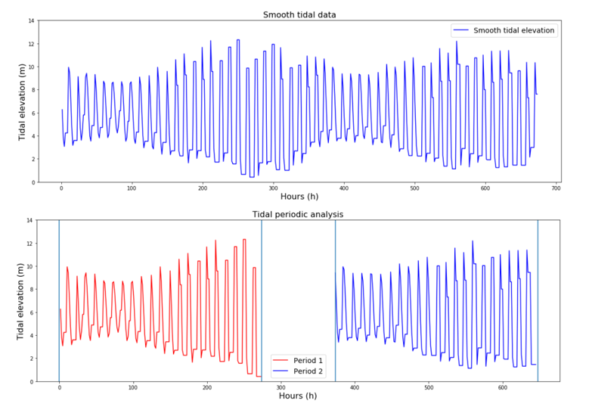
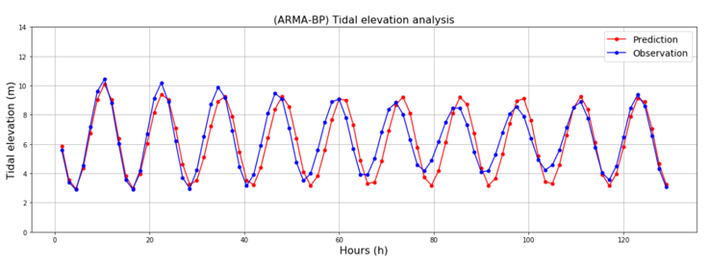
Implementation & Code
Data Preparation
Data Processing
Experimental Method
Select timescale and then read the sample data.
Estimate the periodicity of sample data.
Train BP neural network and use it to make predictions

Slide 7
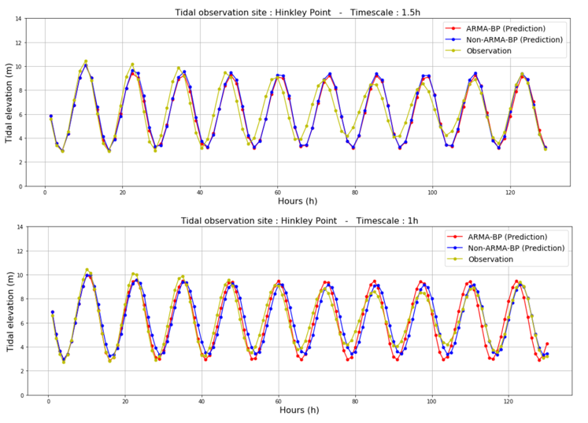
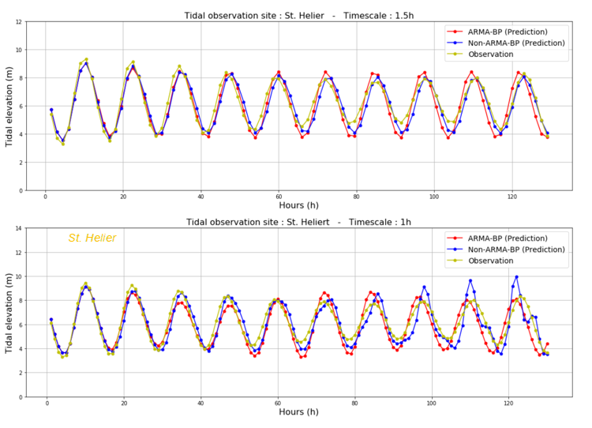
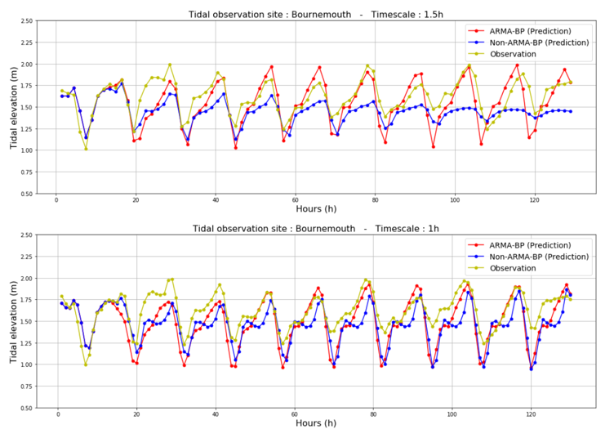
Performance Analysis
Tidal observation site
(Hinkley Point)
Timescales (1.5h / 1h) Prediction methods
(ARMA / Non-ARMA-BP)
Tidal observation site
(St. Helier)
Timescales (1.5h / 1h) Prediction methods
(ARMA / Non-ARMA-BP)
Tidal observation site
(Bournemouth)
Timescales (1.5h / 1h) Prediction methods
(ARMA / Non-ARMA-BP)

Slide 8
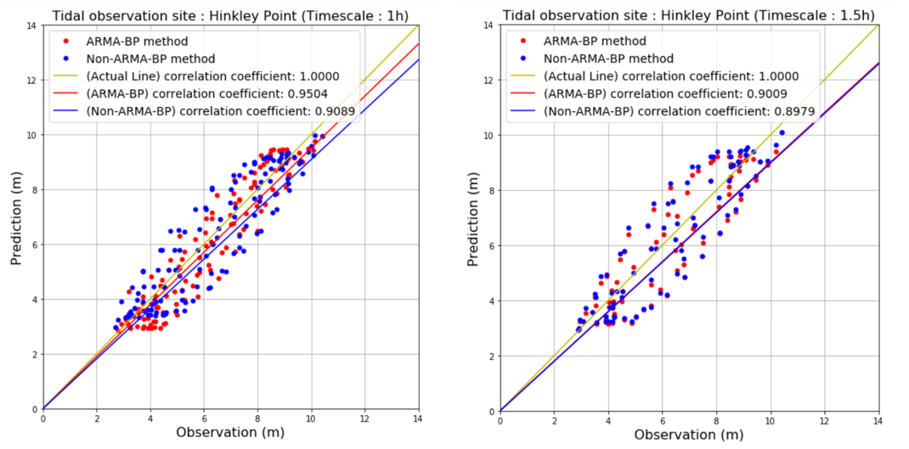
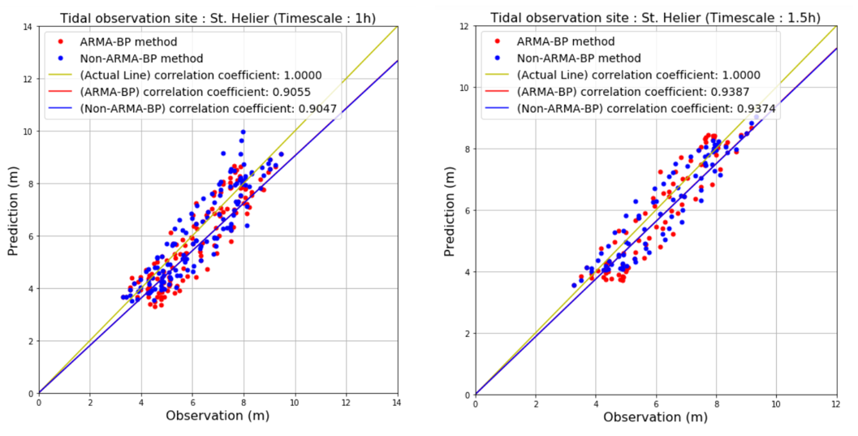
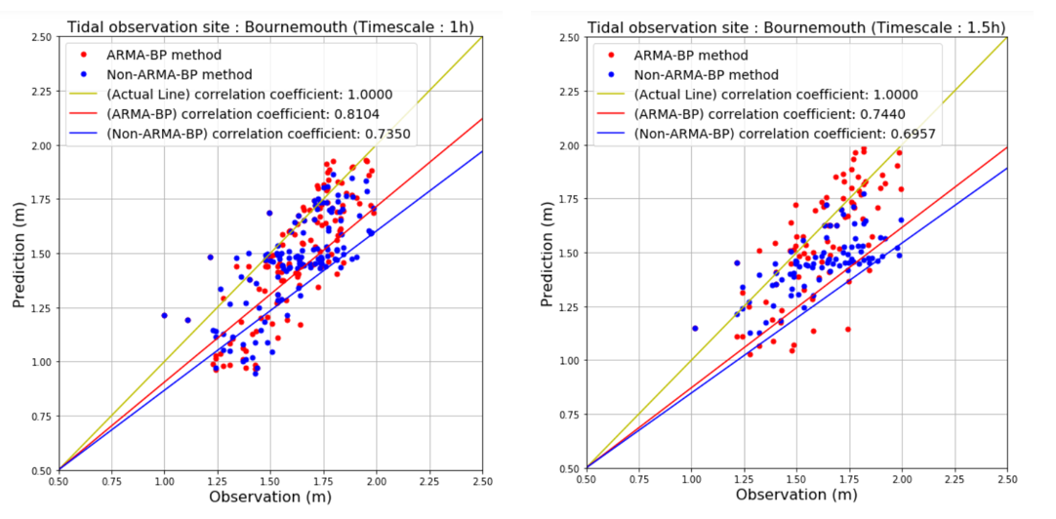

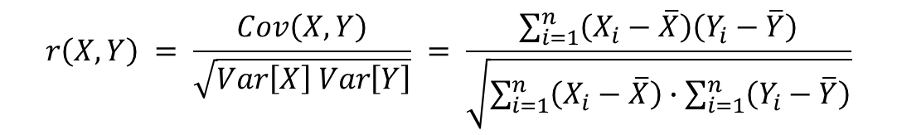
Performance Analysis
To further quantifying performance, one new measurement indicator is introduced, calling the correlation coefficient.
$$r\left(X, Y\right) = \frac{Cov\left(X, Y\right)}{\sqrt{Var\left[X\right] Var\left[Y\right]}} = \frac{\sum_{i=1}^{n}{\left(X_{i}−\overline{X}\right)\left(Y_{i}−\overline{Y}\right)}}{\sqrt{\sum_{i=1}^{n}{\left(X_{i}−\overline{X}\right)}∙\sum_{i=1}^{n}{\left(Y_{i}−\overline{Y}\right)}}}$$
$X_{i} :$ Prediction$Y_{i} :$ Observation
Comparison of correlation coefficients using different timescales (1.5h / 1h) and different prediction methods (ARMA / Non- ARMA-BP).
The tidal observation sites from top to bottom are Hinkley Point, St. Helier and Bournemouth respectively.

Slide 9
Discussion & Conclusion
In general, ARMA-BP (one-step iterative prediction) method dominates over the Non-ARMA-BP (multi-step iterative prediction) method, either on different tidal observation sites or timescales.
For observation points with regular fluctuations, the trained BP neural network can make a relatively accurate prediction. On the contrary, for observation points with relatively disordered fluctuations, the prediction accuracy is usually very poor.
Furthermore, the amplitude of tidal elevation is also a significant point. Larger amplitude means that the observation points are more likely to be uniformly distributed, neither too dense nor too sparse. Uniform data distribution plays a crucial role on improving prediction accuracy.

Slide 10
Discussion & Conclusion
Future Work
Long-term prediction should be focused on. Meanwhile, it is essential to trade-off between prediction accuracy and training time. In order to solve this problem, there are three preliminary ideas: Optimize the raw neural network code structure; Propose a new type of neural network algorithm; Apply tensor computation (Pytorch) to achieve GPU acceleration.
In addition, there is no good prediction method for data with irregular fluctuations at present. If someone would like to continue research in this area, it is better to consider using other prediction methods or combining neural network with other methods.

Slide 11
Q & A

Slide 12
Thanks for your attendance

